Slide 1
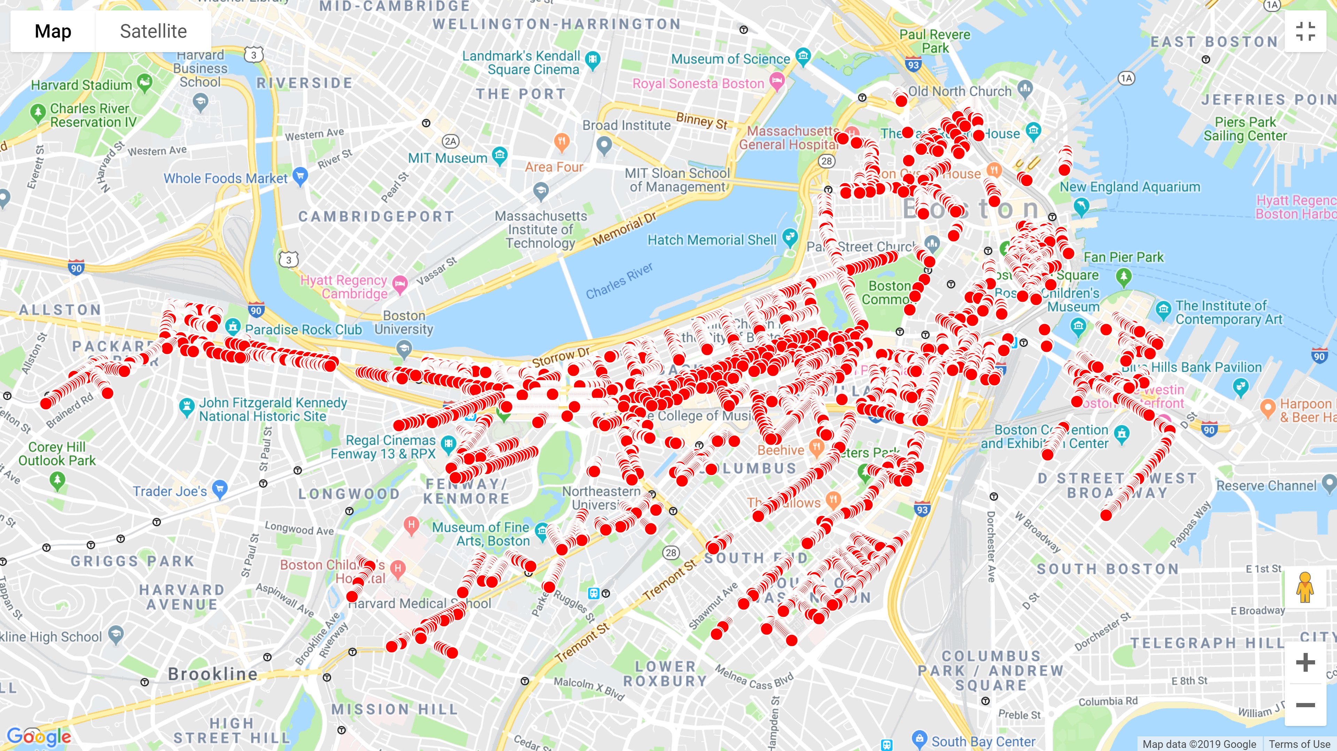


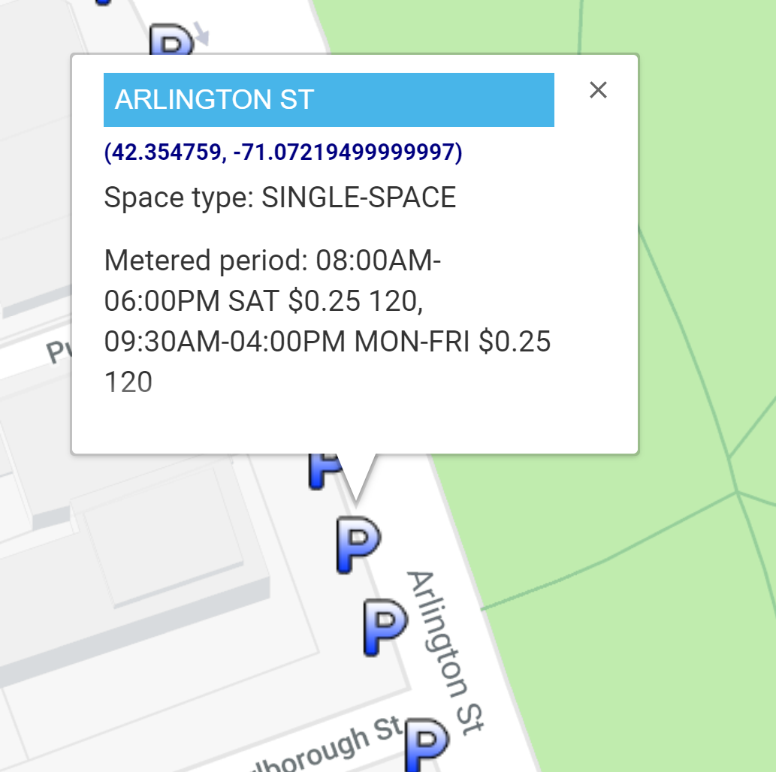
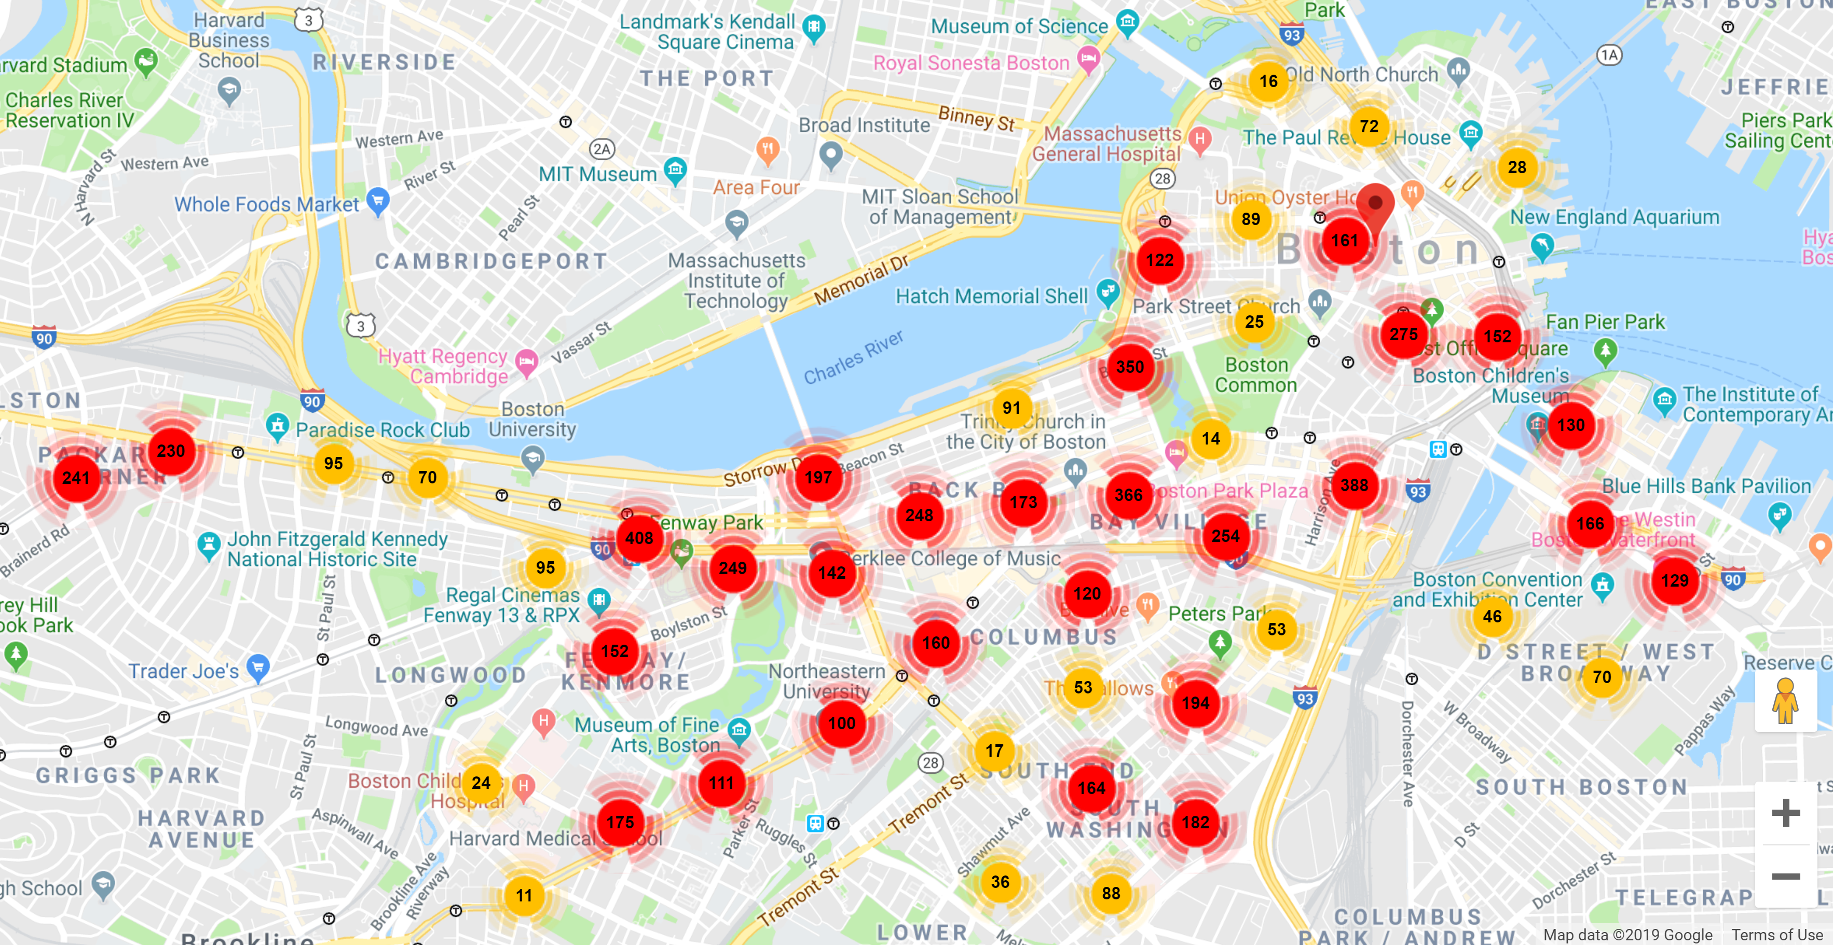
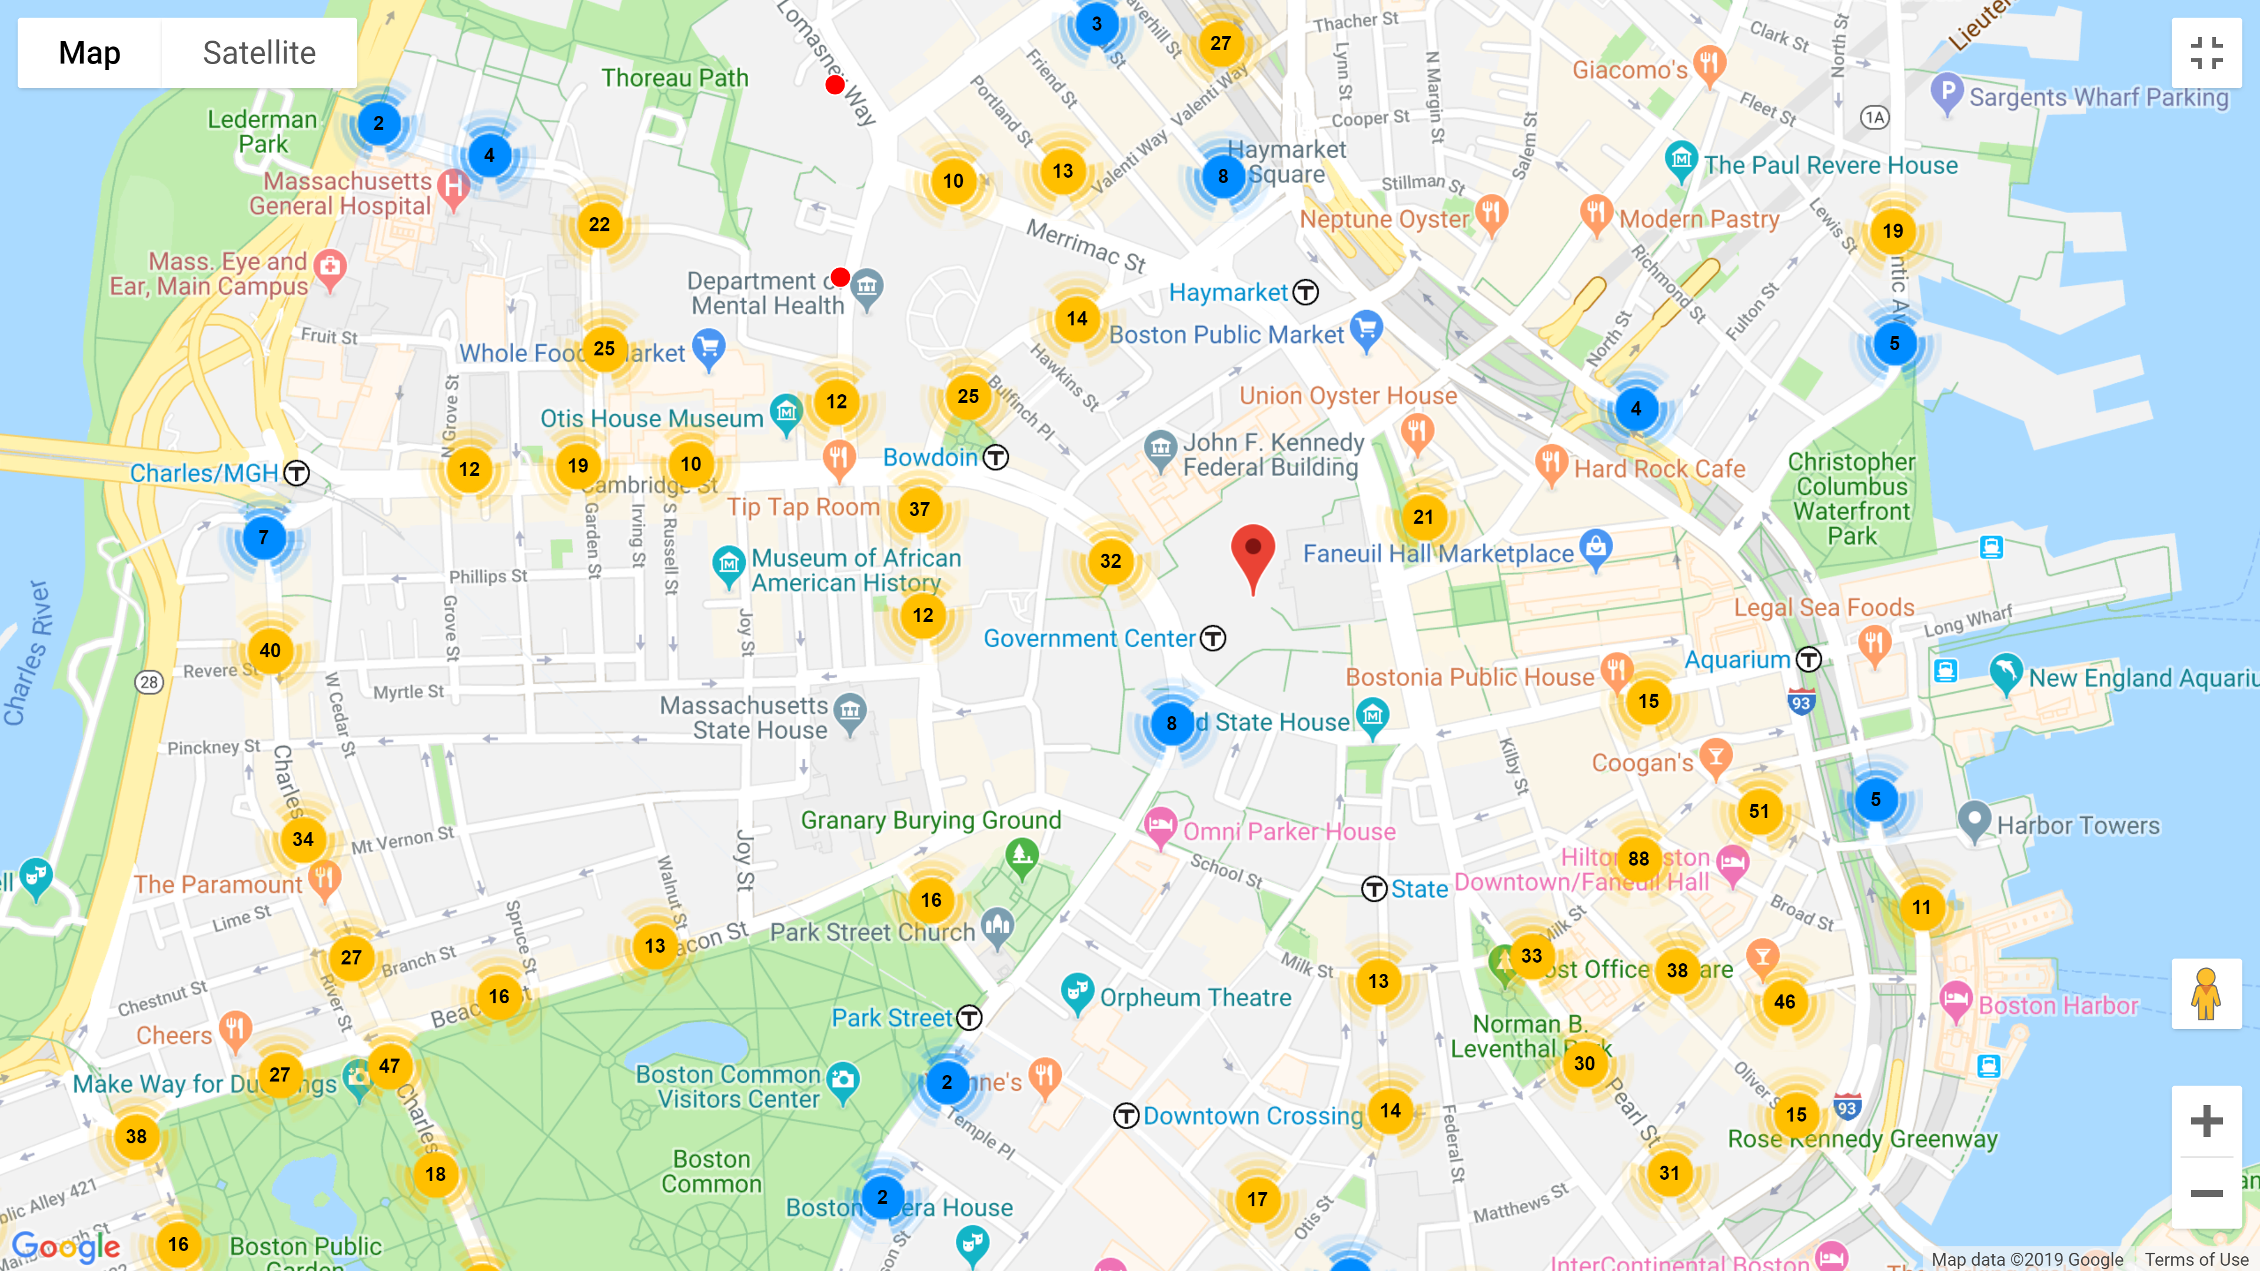
Boston, Big Data, and Web Technologies
Organizing Data
With a large database of 6955 parking meters in the city of Boston, grouping and filtering meters by certain properties makes the data more digestible and patterns more discernable by filtering meters by the most relevant of 41 properties. Entries with missing information are discarded.
ABSTRACT
EXTRACT DATA
Parsing Data
INTERACTIVE MAP
Free parking times in the database are given as 19-23 character length strings that give a range of time periods and days of the week, which isn’t an inherently useful form.
Big Data Problems
Initial plotting of all 7000 parking spaces created tremendous lagging of nearly 7 seconds for each movement. The overlapping markers interfered with users’ processing of the actual number of available parking in any particular region.
EXPLAIN DATA
Marker Clustering
Grouping markers into clusters helps computers keep better track of all the markers’ location by assigning markers to specific regions. Depending on the zoom level, the clusters will merge or break up into other clusters to represent the general region. The number label on each marker cluster tells users the number of available parking of a particular area.

